Slide 1
Processor Architectures At A Glance: M.I.T. Raw vs. UC Davis AsAP
Presenter: Jeremy W. Webb
Course: EEC 289Q: Reconfigurable Computing
Course Instructor: Professor Soheil Ghiasi

Slide 2
Outline
Overview of M.I.T. Raw processor
Overview of UC Davis AsAP processor
Raw vs. AsAP
Conclusion
References
Notes:
- Overview of MIT raw
- Project Goals
- Architecture
- Tile Array
- What's in a tile?
- Tile Detail
- Compute Processor detail
- Router Detail
- Inter-processor Communication
- Contributions
- Novel Features
- Overview of UCD AsAP
- Project Goals
- Architecture
- Tile Array
- What's in a tile?
- Tile Detail
- Inter-processor Communication
- Novel Features
- Contributions
- Raw vs. AsAP (side-by-side arch/performance)
- References.

Slide 3
M.I.T. Raw Processor
Raw Project Goals
M.I.T. raw Architecture Workstation (Raw) Architecture
Raw Processor Tile Array
What’s in a Raw Tile?
Raw Processor Tile
  Inside the Compute Processor
  Raw’s Networking Routing Resources
  Raw Inter-processor Communication
M.I.T. Raw Contributions
M.I.T. Raw Novel Features

Slide 4
Raw Project Goals
Create an architecture that scales to 100’s-1000’s of functional units, by exploiting custom-chip like features while being “general purpose”. ^{[8,9]}
Support standard general purpose abstractions like context switching, caching, and instruction virtualization.
Notes:
The Raw Architecture Workstation (Raw) is a simple, wire-efficient architecture that scales with increasing VLSI gate densities. The Raw architecture's goal is to provide performance that is comparable to that provided by scaling an existing architecture, but that can achieve orders of magnitude more performance for applications in which the compiler can discover and statically schedule fine-grain parallelism. The Raw project's approach to achieving these goals is to implement a simple, highly parallel VLSI architecture, and to fully expose the low-level details of the hardware architecture to the compiler so that the compiler or the software can determine, and implement, the best allocation of resources for each application.

Slide 5
M.I.T. raw Architecture Workstation (Raw) Architecture
Composed of a replicated processor tile. ^{[8]}
8 stage Pipelined MIPS-like 32-bit processor ^{[7]}
Static and Dynamic Routers
Any tile output can be routed off the edge of the chip to the I/O pins.
Chip Bandwidth (16-tile version).
  Single channel (32-bit) bandwidth of 7.2 Gb/s @ 225 MHz.
  14 channels for a total chip bandwidth of 201 Gb/s @ 225 MHz.

Slide 6
Raw Processor Tile Array
^{[8]}
PC
RF
PC
RF
PC
RF
PC
RF
I$
ALU
I$
ALU
I$
ALU
I$
ALU
D$
D$
D$
D$
PC
RF
PC
RF
PC
RF
PC
RF
I$
ALU
I$
ALU
I$
ALU
I$
ALU
D$
D$
D$
D$
PC
RF
PC
RF
PC
RF
PC
RF
I$
ALU
I$
ALU
I$
ALU
I$
ALU
D$
D$
D$
D$
PC
RF
PC
RF
PC
RF
PC
RF
I$
ALU
I$
ALU
I$
ALU
I$
ALU
D$
D$
D$
D$

Slide 7
What’s in a Raw tile?
8 stage Pipelined MIPS-like 32-bit processor ^{[7]}
Pipelined Floating Point Unit
32KB Data Cache
32KB Instruction Memory
Interconnect Routers

Slide 8

Raw Processor Tile
Compute
Processor
Routers
On-chip networks

Slide 9
Inside the Compute Processor
r24
r24
r25
r25
r26
r26
r27
r27
Input
FIFOs
from
Static
Router
Output
FIFOs
to
Static
Router
E
M1
M2
A
TL
TV
IF
D
RF
F
P
U
F4
WB
Notes:
networks are integrated directly into the bypass paths

Slide 10
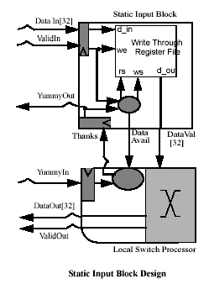
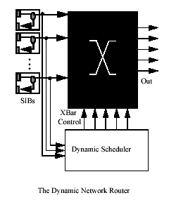
Raw’s Networking Routing Resources
2 Dynamic Networks^{[7]}
  Fire and Forget
  Header encodes destination
  2 Stage router pipeline
2 Static Networks
  Software configurable crossbar
  Interlocked and Flow Controlled
  5 Stage static router pipeline
  3 cycle nearest-neighbor ALU to ALU communication latency
  No header overhead, but requires knowledge of communication patterns at compile time
Notes:
The static router controls the static networks, which are used as point-to-point scalar
transport for operands between the tiles. The dynamic routers and networks are used for all
other traffic such as memory, interrupts, I/O, and message passing codes.

Slide 11
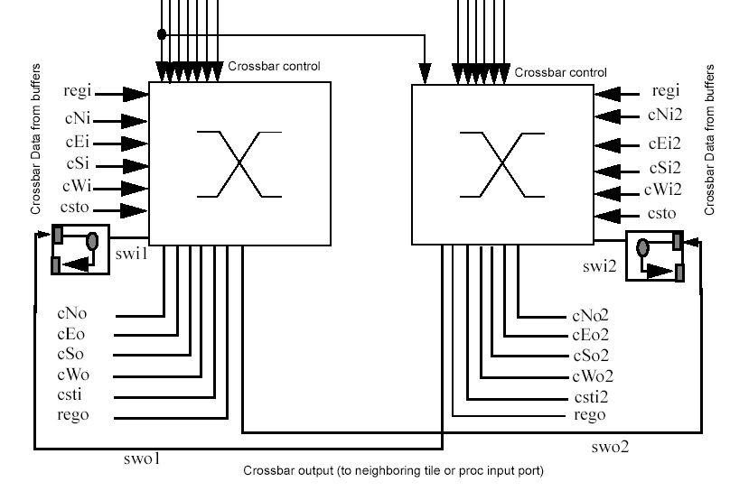
Raw Inter-processor Communication
^{[5,6]}

Slide 12
M.I.T. Raw Contributions
Raw’s communication facilitates exploitation of new forms of parallelism in Signal Processing applications ^{[7]}

Slide 13
M.I.T. Raw Novel Features
Dynamic and Static Network Routers.
Scalability of Raw chips.
  Fabricated Raw chips can be placed in an array to further increase the system computing performance.
Exposes the complete details of the underlying HW architecture to the SW system.
Notes:
First, Raw implements fine-grain communication between large numbers of replicated processing elements and, thereby, is able to exploit huge amounts of fine-grain parallelism in applications, when this parallelism exists. Second, it exposes the complete details of the underlying hardware architecture to the software system (be it the software CAD system, the applications software, or the compiler), so the software can carefully orchestrate the execution of the application by applying techniques such as pipelining, synchronization and conflict elimination for shared resources by static scheduling and routing.

Slide 14
UC Davis AsAP Processor
AsAP Project Goals
UC Davis Asynchronous Array of simple Processors (AsAP) Architecture
Asynchronous Array of simple Processors
What’s in an AsAP Tile?
AsAP Single Processor Tile
AsAP Contributions
AsAP Novel Features

Slide 15
AsAP Project Goals
AsAP’s proposed architecture targets four key goals: ^{[3]}
Well matched with DSP system workloads.
High-throughput.
Energy-efficient.
Address the opportunities and challenges of future VLSI fabrication technologies.
Notes:
Example 802.11a wireless LAN
Seeks an architecture that permits a significant proportion of the die dedicated to datapath circuits.
Small amount of local memory
Very high clock rate processors, and is programmable and potentially reconfigurable.

Slide 16
UC Davis Asynchronous Array of simple Processors (AsAP) Architecture
Composed of a replicated processor tile.
9-stage pipelined reduced complexity DSP processor ^{[2]}
Four nearest neighbor inter-processor communication.
Individual processor tile can operate at different frequencies than its neighbors.^{[2]}
Off chip access to the I/O pins must be reached by routing to boundary processors.
Chip Bandwidth
  Single channel (16-bit) bandwidth of 16 Gb/s @ 800 MHz.
The array topology of AsAP is well-suited for applications that are composed of a series of independent tasks. ^{[2]}
  Each of these tasks can be assigned to one or more processors.
Notes:
16-bit fixed point single issue CPU
ALU, MAC
Small Instruction/Data Memories
Hardware address generation
Local programmable clock oscillator
~1.1mm²/processor in 0.18μm CMOS
1GHz targeted operation

Slide 17
Asynchronous Array of simple Processors
Notes:
AsAP limits interprocessor communication to “four nearest neighbors”. Many algorithms have a linear data flow, so this is more than adequate.
For algorithms requiring more complex communication, some processors may be allocated to route or forward data. However, because the processors are
fairly small, this is probably not to big of loss.
All interprocess communication is asynchronous. Each processor contains its own clock oscillator. Data is synchronized across clock domains using dual clock FIFOs. These also act to buffer data in case of a rate mismatch between producer and consumer.
Stalling: If a processor attempts to read from an empty FIFO or write to a full FIFO, it will stall, until the instruction is able to safely complete. Hence, interproc. communication is automatically handled in hardware.

Slide 18
What’s in an AsAP tile?
16-bit fixed point datapath single issue CPU ^{[1]}
  Instructions for AsAP processors are 32-bits wide. ^{[2]}
ALU, MAC
Small Instruction/Data Memories
  64-entry instruction memory and a 128-word data memory.^{[2]}
Hardware address generation
  Each processor has 4 address generators that calculate addresses for data memory. ^{[2]}
Local programmable clock oscillator
2 Input and 1 Output 16-bits wide and 32-words deep dual-clock FIFOs. ^{[2]}
~1.1mm²/processor in 0.18μm CMOS
800 MHz targeted operation

Slide 19
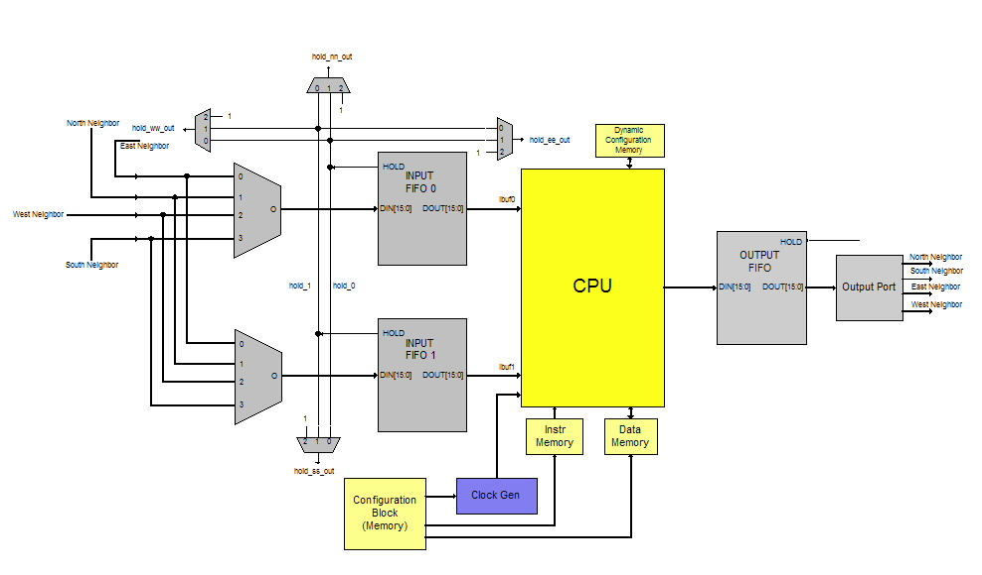
AsAP Single Processor Tile

Slide 20
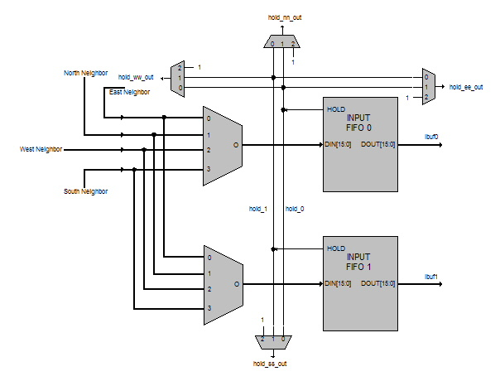
AsAP Inter-processor Communication
Each processor output is hard-wired to its four nearest neighbors input multiplexers.
At power-up the input multiplexers are configured.
As input FIFOs fill up the sourcing neighbor can be halted by asserting corresponding hold signal.

Slide 21
AsAP Contributions
Provides parallel execution of independent tasks by providing many, parallel, independent processing engines ^{[3]}
AsAP specifies a homogenous 2-D array of very simple processors
  Single-issue pipelined CPUs
Independent tasks are mapped across processors and executed in parallel
Allows efficient exploitation of Application-level parallelism.
Notes:
To overcome the drawbacks of sequential execution and large memory higherarchies, we simply provide many independent processing engines, each with its own memory and code space.
Our AsAP architecture does that by defining an 2-D array of processors. Because each processor performs only a small subset of the application, it can be simpler than most modern CPUs. We chose a simple single-issue processor following a traditional RISC architecture.
Most DSP systems are already partitioned into a cascade of blocks. These blocks map easily onto AsAP processors. Because each processing element is a complete CPU, the coding process simply consists of defining each block in software.
The result is an efficient exploitation of Application Level parallelism: That is, each block of the algorithm executes in parrallel with other blocks, on independent data. This effectively creates a pipeline, similar to what might be built into an ASIC solution.
** TRANSITION **
Before seeing how this mapping works for 11a, I’ll discuss some details of the AsAP architecture.

Slide 22
AsAP Novel Features
AsAP
  Many processing elements
  High clock rates
  Possibly many processors inactive
  Activity localized to increase energy efficiency and performance
  Active
  Routing
  Inactive (off)

Slide 23
Raw vs. AsAP
Parameter | IBM SA-27E (Raw) ^{[4,5,6]} | UC Davis AsAP (estimated) ^{[1]}
Litho | 180 nm | 180 nm
Design Style | Std Cell ASIC | Full Custom
Clk Freq (MHz) | 425 | 800
BW per I/O Bus | 13.6 Gb/s | 12.8 Gb/s
# tiles/chip | 64 | 405
CPU type | 8-stage MIPS (32-bit floating point) | 9-stage reduced complexity DSP (16-bit fixed point)
Die Area | 331 mm² | ~445 mm²
Tile Area | ~5 mm² | 1.1 mm²
Notes:
Here is a comparison of the two implementations. Both Raw and the P3 Coppermine are implemented in the same lithography generation.
The next three items compare the interconnect of the two processors. As you can see, Raw has copper wires, while Intel has a better dielectric
And performs aggressive wire sizing. Overall, my guess is that the interconnect for the two processes is relatively even.
In the next couple of items, Intel has a clear advantage. As measured by FO1 delay, the transistors of the Intel processors are significantly better,
Almost twice as fast. Intel gets to use a full custom methodology, and tweaked their voltage to 10% above nominal.
When choosing the frequency of the two processors, we had a bit of problem. Raw has a single frequency, but the Intel processor has
A range of frequencies. What is going on here is that Intel is able to take advantage of statistical variations in their process. Some parts
run fast and some run slow. For the P3, we chose the middle of the frequency range, presumably representing an average speedbin part.
On the last two items, Raw has the advantage, we have 5 times as many pins and 3 times as much area. The goal here is to demonstrate
That Raw is scalable – that we can take advantage of as many resources as can be thrown at it.

Slide 24
Conclusion
The M.I.T. Raw and UC Davis AsAP processors set out to
accomplish similar goals, and to some extent have
accomplished them.
While Raw has a smaller number of processors per chip and
more memory, AsAP has a larger number of processors per
chip with the ability to distribute the memory hogging tasks
over multiple processors. This will certainly allow these
processors to compete in many of the same markets.
Notes:
Raw and AsAP processors set out to accomplish similar goals, and to some extent have fully accomplished them.
While Raw has a smaller number of processors per chip and more memory, AsAP has a large number of processors per chip with the ability to distribute the memory hogging tasks over multiple processors. This will certainly allow these processor to compete many of the same markets.

Slide 25
References
[1] Michael J. Meeuwsen, Omar Sattari, Bevan M. Baas, “A Full-rate Software Implementation of an IEEE 802.11a Compliant Digital Baseband Transmitter,” In Proceedings of the IEEE Workshop on Signal Processing Systems (SIPS '04), October 2004.
[2] Omar Sattari, "Fast Fourier Transforms on a Distributed Digital Signal Processor," Masters Thesis, Technical Report ECE-CE-2004-7, Computer Engineering Research Laboratory, ECE Department, University of California, Davis, Davis, CA, 2004.
[3] Bevan M. Baas, "A Parallel Programmable Energy-Efficient Architecture For Computationally-Intensive DSP Systems," In Signals, Systems and Computers, 2003. Conference Record of the Thirty-Seventh Asilomar Conference, November 2003.
[4] Michael Taylor, “Evaluating the Raw Microprocessor,” presented at the Boston Architecture Research Conference, January 30, 2004
[5] Michael Bedford Taylor, “Design Decisions in the Implementation of a Raw Architecture Workstation,” MS Thesis, Massachusetts Institute of Technology, Cambridge, MA, September, 1999.
[6] Michael Bedford Taylor, “The Raw Processor Specification (LATEST),” Comprehensive specification for the Raw processor, Cambridge, MA, Continuously Updated 2003.
[7] David Wentzlaff, Michael Bedford Taylor, et al., “The Raw Architecture: Signal Processing on a Scalable Composable Computation Fabric,” High Performance Embedded Computing Workshop, 2001
[8] Michael Taylor, "Evaluating The Raw Microprocessor: Scalability and Versatility," Presented at the International Symposium on Computer Architecture, June 21, 2004
[9] M.I.T. raw Architecture Workstation website: http://cag-www.lcs.mit.edu/raw/purpose/

